Slide 1
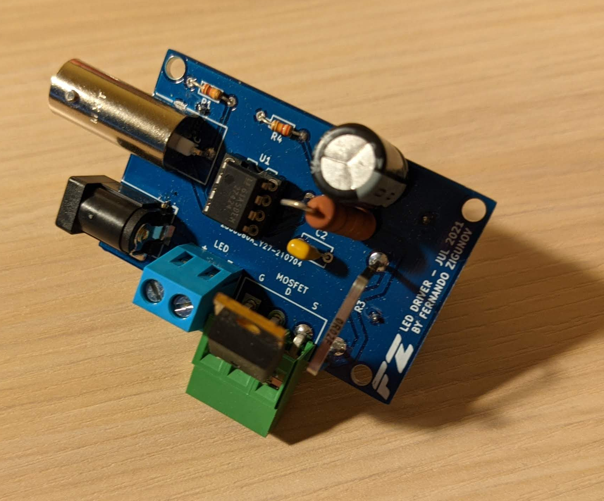
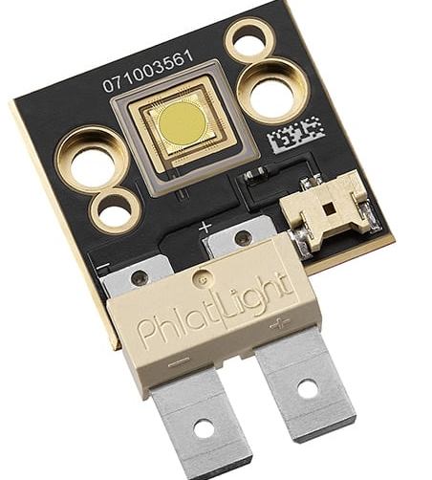
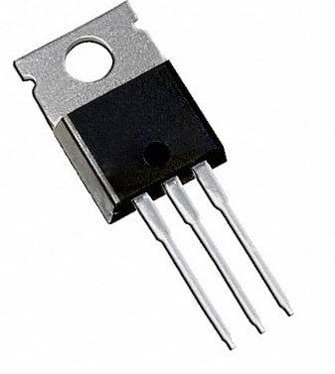
Provide input waveform
in this BNC
(5V=on, will switch on for as long as pulse is active)
Typical pulse width 500ns to 5us
DIP8 Socket for UCC27424P
(If not operated within specs this component burns, socket is for easy replacement)
+24V input voltage here
(up to 3A)
Can use a power supply rated for less current if known avg current is lower
Terminals to LED
(make wires as short as possible for fast switching)
Screw terminal for IRF3805 MOSFET
(If not operated within specs this component burns, so this is for easy replacement)
G=GATE, D=DRAIN, S=SOURCE
DON’T CONNECT INCORRECTLY!!
Black plastic body must be facing outward

Slide 2
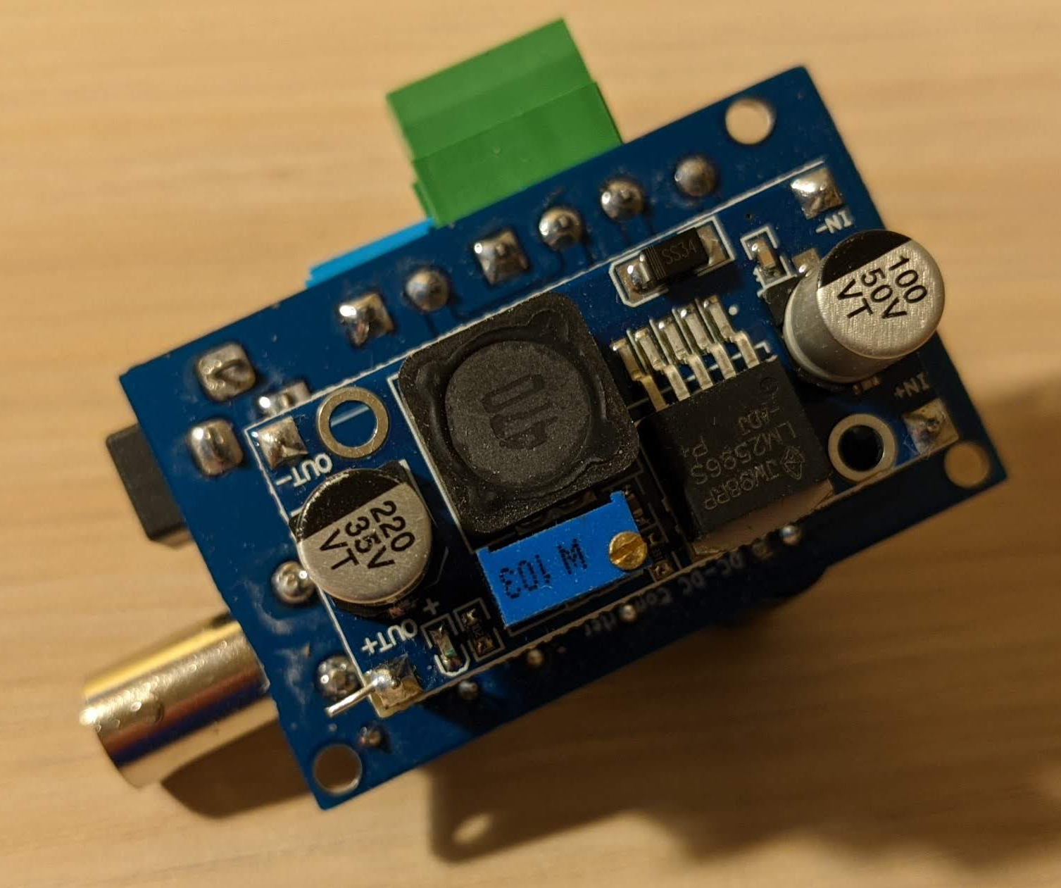
LM2596 based Boost Converter
Solder header pin terminals for easy connection to the main PCB
(MAKE SURE TO CONNECT IT IN THE RIGHT ORIENTATION!)
Once LED is connected you can connect an oscilloscope to this resistor to measure the current going to the LED. (Use Ohm’s law)
DO NOT EXCEED 150A! It will burn the LED!
If unsure, you can connect a short-circuit wire to the LED terminals to measure the current before connecting the LED.
Voltage output adjustment screw
Start with ~8V before connecting LED.

